Slide 1


Energy Policy Roundtable
The Promise of Energy Storage in the PJM Footprint
February 21, 2017

Slide 2
About AMS
Advanced Microgrid Solutions (“AMS”) is a developer and operator of intelligent energy storage systems:
Provides grid services to utilities and ISOs
Offers energy savings to host customers with no upfront investment
Dynamically optimizes fleet operation
Market leader in fast-growing energy storage market
Industry first 50 MW / 200 MWh utility capacity contract with Southern California Edison
  Currently 120 MW / 500MHh of storage under contract
Enterprise level agreements The Irvine Company, CSU, Morgan Stanley REIT, and multiple water districts
$200M of project equity raised from Macquarie Capital
  Largest storage financing to date
Advanced software platform for fleet management and co-optimization

Slide 3
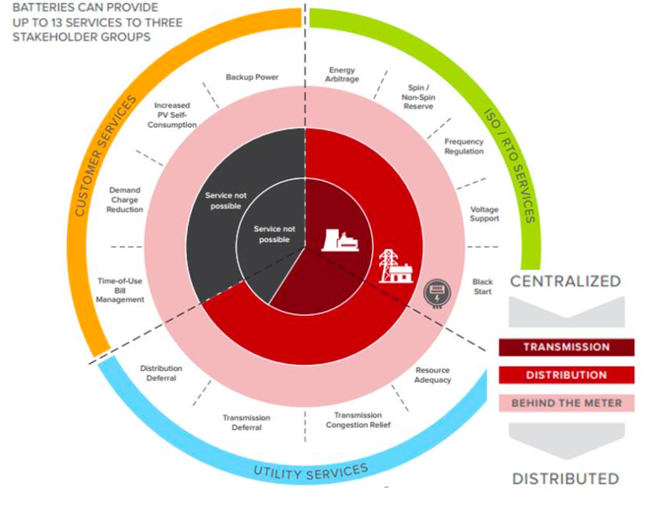
Behind the meter installations unlock multiple benefits streams
Source: Rocky Mountain Institute
Notes:
13 discrete services, 3 markets

Slide 4


STORAGE AS A SERVICE
Host customers receive cost savings, operational efficiencies and market revenues with no capital outlay and no technology risk
Utilities receive firm, dispatchable energy products that are clean, flexible and competitively priced – and keep their customers happy
AMS recruits the host customers, negotiates the utility agreements, and manages the assets
AMS finances the projects with a combination of fixed services fees from hosts, utility revenues, incentives and/or grants
Energy Savings
Services Fee
Host Customer
Own & Operate
Battery Storage
AMS
Grid
Services
Utility
Contract
Utility
BUSINESS MODEL

Slide 5


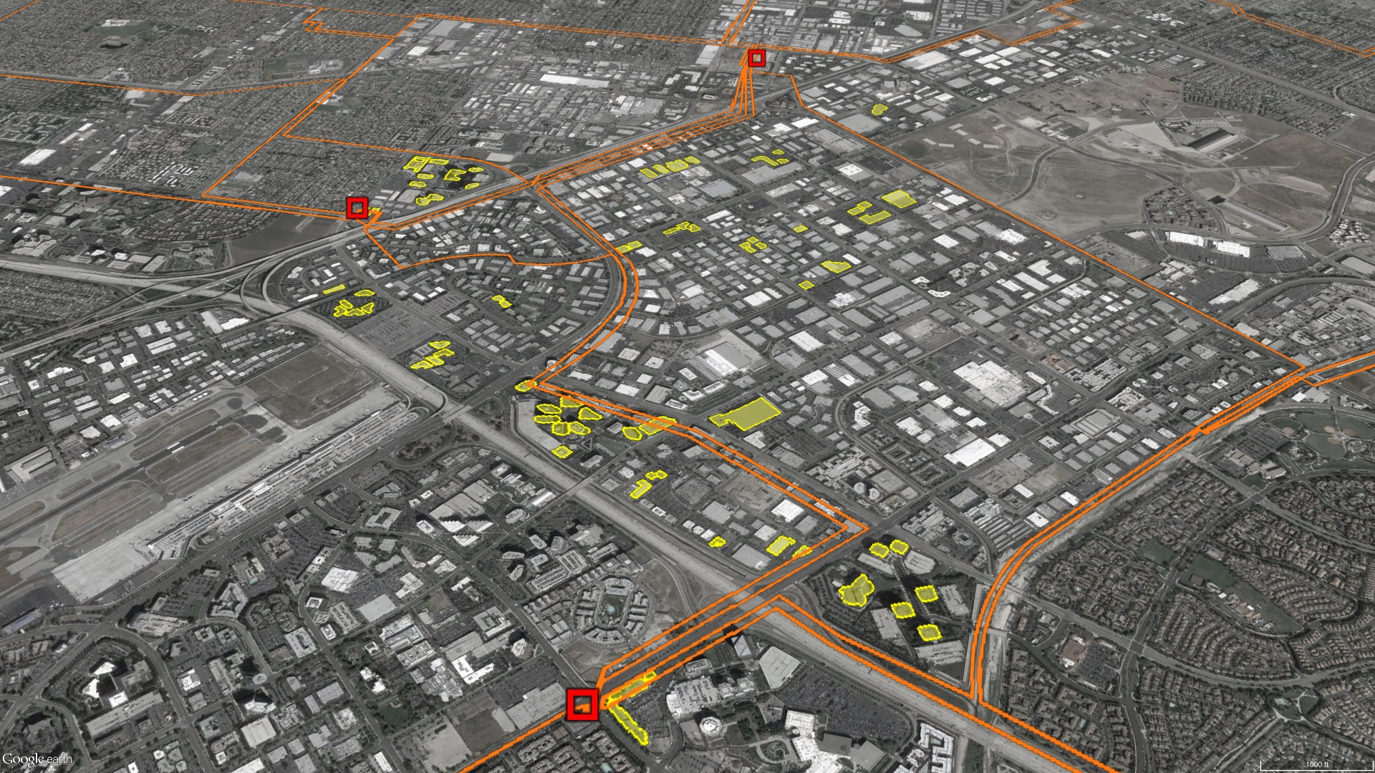
Local Capacity / Grid Support
Southern California Edison: 50 MW local capacity for grid support services from Behind the Meter Energy Storage.
Project Parameters:
50MW / 300MWH of energy storage resources deployed across 100 C&I customer sites
Average installation size = 500kW
Contract Parameters:
400 - 600 hours dispatch per year
Dispatch window: 9 a.m to 6 p.m.
Delivery Term: January - December

Slide 6
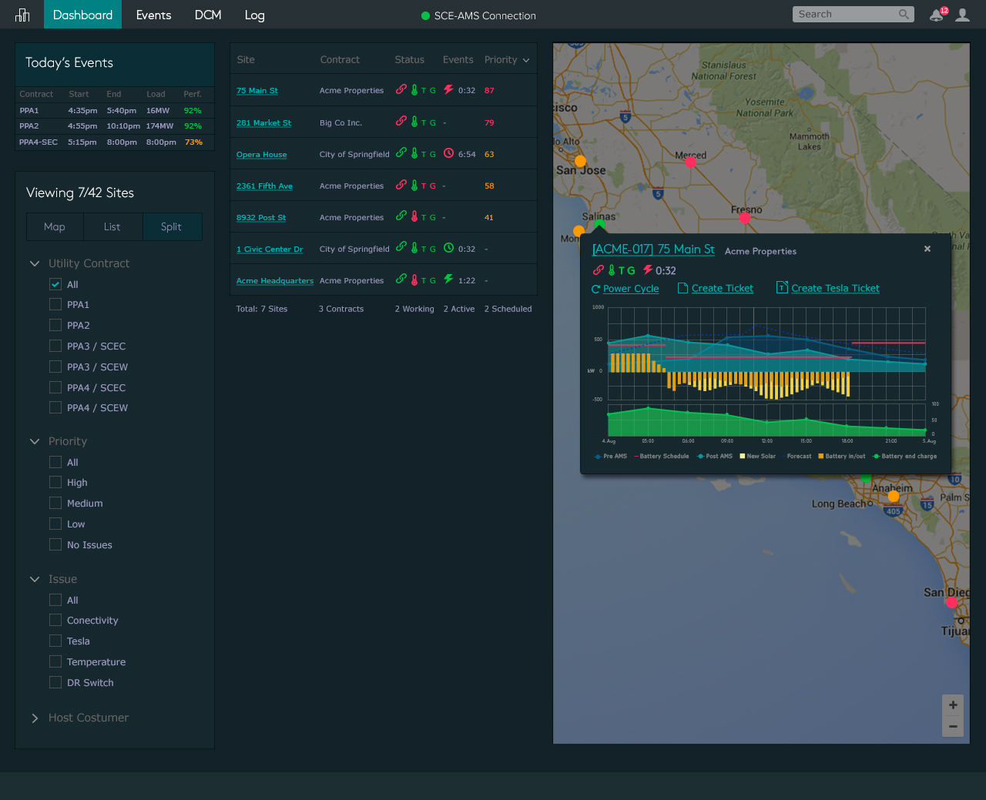
AGGREGATED DISTRIBUTED ENERGY RESOURCES
END TO END VALUE CHAIN
Utility/grid operators
End use customer
Distributed Resource Aggregator
Asset Management, O&M, NOC,
Active Energy Management
Distribution level services
Grid Edge services
Firm Dispatchable Capacity
Dynamic Load Mgmt.
Volt/VAR Optimization
Conservation Voltage Reduction
Wholesale Energy Market Products
Day Ahead
Real-time
Regulation
Peak Shaving
(GHG Reduction)
Energy Cost Reduction
Energy Islanding/
Critical Loads
Demand Response Revenue Generation
Solar Integration
EV Charging Integration

Slide 7
HYBRID-ELECTRIC BUILDING
1
DEMAND MANAGEMENT
2
LOAD SHIFTING
3
UTILITY DISPATCH
1
POWER (kW)
2
3

Slide 8


10 MW Fleet of Hybrid-Electric Buildings
24 class A commercial office buildings
25% permanent reduction in peak demand
10 MW of firm, disptachable capacity to the utility
10% reduction in energy costs to Host Customer
Zero emissions
Carbon Neutral

Slide 9
IRVINE COMPANY | 250 kW – 1500kWh

Slide 10
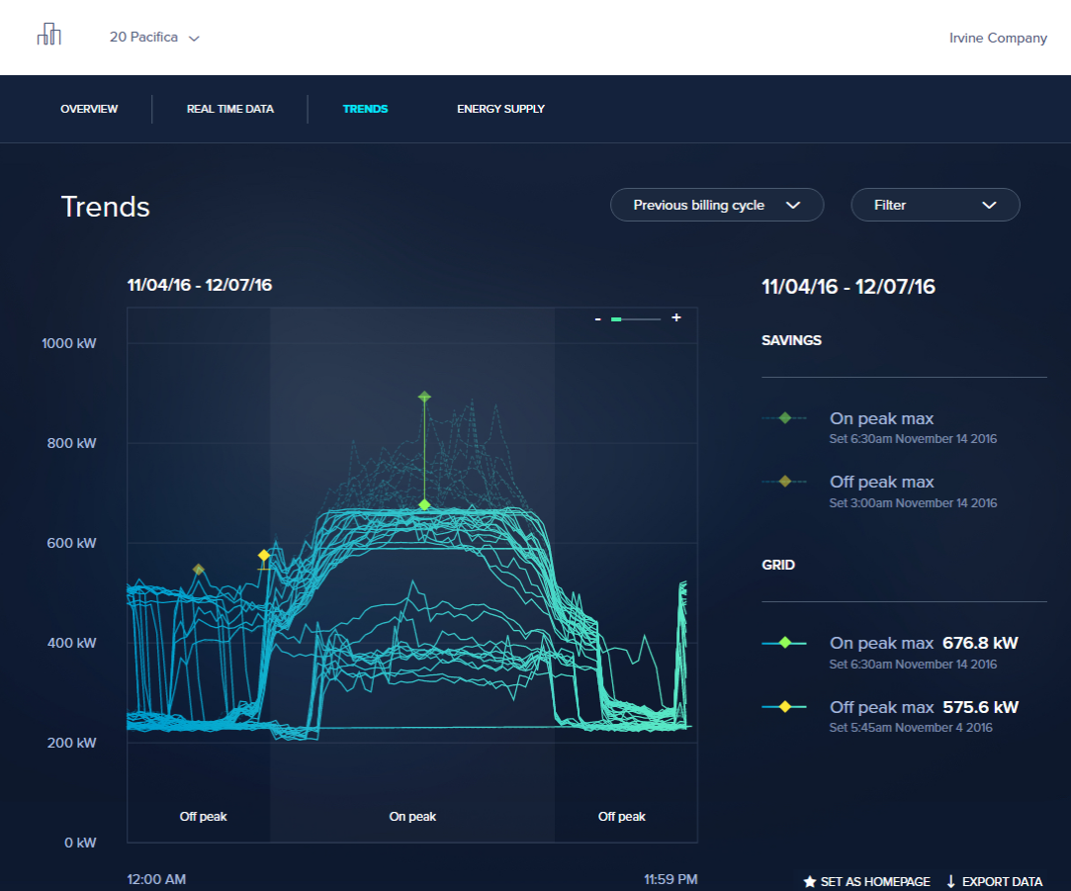
HOST CUSTOMER PORTAL
Notes:
https://redshift.invisionapp.com/share/Z971S3LCM#/screens/152726009

Slide 11
SOLUTION IN ACTION
Utility dispatch
Demand Management

Slide 12


ratepayer impacts of Energy storage
single use economic models for storage sub-optimize cost allocations
Services Provided
Cost Recovered
Battery Storage
Distribution
Utility
Ratepayers

Slide 13





ratepayer impacts of Energy storage
Stacked benefits models optimize cost allocations by spreading costs over multiple markets
Wholesale market
Services Provided
Cost Recovered
Battery Storage
Distribution
Utility
Ratepayers
Host Customer Site

Slide 14
Key Issues facing the Energy storage market
Appropriately valuing storage attributes
  Clean, fast response, durable, dispatchable
  Locational value
  New products like VVO and EE
Market access
  “Benefits stacking” and simultaneous multiple use
  Distribution values (LMP+D)
  ISO markets
  Tariff structures
State regulatory support
  Storage targets and incentives
FERC NOPR
Utility procurement cycle
  Terms that support capital financing
  Market trajectory and economies of scale
  The role of pilot/demonstration projects
Propagation of success stories in CA, NY, MA and other markets

Slide 15

25 Stillman St, Suite 200
San Francisco, CA 94107
www.advmicrogrid.com
Kelly Warner
President
KellyW@advmicrogrid.com

